Slide 1


Students’ Train Process Management
Supervisor: Mr. Kiều Trọng Khánh
Group members:
 Chou Tùng Đạt – Team Leader – SE61762
 Nguyễn Hoàng Hiệp – Team Member – SE61627
 Tô Chí Cường – Team Member – SE61712
 Phan Hữu Thiện – Team Member – SE61426

Slide 2


Students’ Train Process Management
01
Introduction
02
Current Situation
03
Problems
05
Solutions
06
Outcome and limitation
04
Approach

Slide 3

Students’ Train Process Management
Introduction
What is this project about?
The topic is aimed at providing solutions for optimizing student’s training process, so that we focus on standardized existing data to ensure the correctness of data. In addition, system can provide statistics and provide academic managing functions with standardized data that the old systems cannot.

Slide 4
Students’ Train Process Management
Introduction
What is this project about?
Why this project being implemented?
The processing of data in student’s training management system have to face with many difficulties.
One of the most difficult is hand-processing data in excel which will consumes a lot of time and hard to ensure the data is correct.
Current system having issues in moving data to each other which lead to export incorrect data, the training process is not optimized.

Slide 5
Students’ Train Process Management
Introduction
What is this project about?
Why this project being implemented?
How is this project be implemented ?
Project will follow the extreme programming method.
Database is designed to be applied.
All data will be standardized.
New training system will be built in a structured way for easy extraction and computation
Notes:
Gap truc tiep ng dung de lay yeu cau xay dung phan mem
-> requirement -> save to -> story card

Slide 6
Students’ Train Process Management
Current Situation
Training processes
Current system
Completion on period
Tasks

Slide 7
Students’ Train Process Management
Current Situation
Training processes
Current system
Make statistic report
Completion on period
Tasks

Slide 8

Students’ Train Process Management
Current Situation
Training processes
Current system
Preparation tasks for next semester
Make statistic report
Completion on period
Current system
Tasks

Slide 9
Students’ Train Process Management
Current Situation
Training processes
Current system
Preparation tasks for next semester
Make statistic report
Completion on period
Not support
Current system
Tasks

Slide 10

Students’ Train Process Management
Current Situation
Training processes
Current system
Preparation tasks for next semester
Make statistic report
Completion on period
Staff
Not support
Current system
Tasks

Slide 11

Students’ Train Process Management
Current Situation
Training processes
Current system
Preparation tasks for next semester
Make statistic report
Completion on period
Staff
Not support
Manual handling
Current system
Multiple excel files
Tasks

Slide 12
Students’ Train Process Management
Current Situation
Training processes
Current system
Preparation tasks for next semester
Make statistic report
Completion on period
Staff
Not support
Manual handling
Current system
Multiple excel files
Tasks

Slide 13
Students’ Train Process Management
Current Situation
Training processes
Current system
Staff

Slide 14
Students’ Train Process Management
Current Situation
Training processes
Current system
Staff
Multiple excel files

Slide 15
Students’ Train Process Management
Current Situation
Training processes
Current system
Manual handling
Staff
Multiple excel files

Slide 16

Students’ Train Process Management
Current Situation
Training processes
Current system
Confusion
Manual handling
Staff
Multiple excel files

Slide 17

Students’ Train Process Management
Current Situation
Training processes
Current system
Confusion
Manual handling
Staff
Multiple excel files
Not verified report

Slide 18
Students’ Train Process Management
Current Situation
Training processes
Current system
Confusion
Manual handling
Staff
Multiple excel files
Not verified report

Slide 19

Students’ Train Process Management
Current Situation
Training processes
Starting University
Student

Slide 20

Students’ Train Process Management
Current Situation
Training processes
Starting University
Staff
Student

Slide 21
Students’ Train Process Management
Current Situation
Training processes
Starting University
Manage
Staff
Student

Slide 22

Students’ Train Process Management
Current Situation
Training processes
Starting University
Manage
Staff
Student
Personal information

Slide 23
Students’ Train Process Management
Current Situation
Training processes
Starting University
Manage
Staff
Student
Fullname
Address
Birthday
Personal information

Slide 24

Students’ Train Process Management
Current Situation
Training processes
Starting University
Manage
Staff
Student
Fullname
Address
Birthday
Personal information
Program

Slide 25
Students’ Train Process Management
Current Situation
Training processes
Starting University
Manage
Staff
Student
Fullname
Address
Birthday
SE – Software Engineering
BA – Business Administrator
Personal information
Program

Slide 26

Students’ Train Process Management
Current Situation
Training processes
Starting University
Curriculum
Manage
Staff
Student
Fullname
Address
Birthday
SE – Software Engineering
BA – Business Administrator
Personal information
Program

Slide 27
Students’ Train Process Management
Current Situation
Training processes
Starting University
Initial stage
Specialized stage
OJT
Major Specialized stage
Curriculum
Manage
Staff
Student
Fullname
Address
Birthday
SE – Software Engineering
BA – Business Administrator
Personal information
Program

Slide 28

Students’ Train Process Management
Current Situation
Training processes
Starting University
Initial stage
Specialized stage
OJT
Major Specialized stage
Curriculum
Subject with credits
Manage
Staff
Student
Fullname
Address
Birthday
SE – Software Engineering
BA – Business Administrator
Personal information
Program

Slide 29

Students’ Train Process Management
Current Situation
Training processes
Starting University
Initial stage
Specialized stage
OJT
Major Specialized stage
Curriculum
Subject with credits
Manage
Accumulated Credits
Staff
Student
Fullname
Address
Birthday
SE – Software Engineering
BA – Business Administrator
Personal information
Program

Slide 30

Students’ Train Process Management
Current Situation
Training processes
Starting University
Initial stage
Specialized stage
OJT
Major Specialized stage
Specialized credits
Curriculum
Subject with credits
Manage
Accumulated Credits
Staff
Student
Fullname
Address
Birthday
SE – Software Engineering
BA – Business Administrator
Personal information
Program

Slide 31
Students’ Train Process Management
Current Situation
Training processes
Starting University
During training process
Student

Slide 32

Students’ Train Process Management
Current Situation
Training processes
Starting University
During training process
Student
Students’ status in each semester

Slide 33
Students’ Train Process Management
Current Situation
Training processes
Starting University
During training process
Student
HD – HL – CO – G - BL
Students’ status in each semester

Slide 34

Students’ Train Process Management
Current Situation
Training processes
Starting University
During training process
Student
Subject
HD – HL – CO – G - BL
Students’ status in each semester

Slide 35
Students’ Train Process Management
Current Situation
Training processes
Starting University
During training process
Student
Attended Subject
Multiple times
Subject
HD – HL – CO – G - BL
Students’ status in each semester

Slide 36

Students’ Train Process Management
Current Situation
Training processes
Starting University
During training process
Student
Attended Subject
Multiple times
Subject
Last Subject mark
HD – HL – CO – G - BL
Students’ status in each semester

Slide 37

Students’ Train Process Management
Current Situation
Training processes
Starting University
During training process
Last Subject status
Student
Attended Subject
Multiple times
Subject
Last Subject mark
HD – HL – CO – G - BL
Students’ status in each semester

Slide 38
Students’ Train Process Management
Current Situation
Training processes
Starting University
During training process
Student

Slide 39

Students’ Train Process Management
Current Situation
Training processes
Starting University
During training process
Curriculum
Student

Slide 40
Students’ Train Process Management
Current Situation
Training processes
Starting University
During training process
Change Curriculum
Curriculum
Student

Slide 41
Students’ Train Process Management
Current Situation
Training processes
Starting University
During training process
Change Curriculum
Curriculum
Student
Manager’s approval

Slide 42
Students’ Train Process Management
Current Situation
Training processes
Starting University
During training process
Change Curriculum
Curriculum
Student
Wait for approval
Manager’s approval

Slide 43
Students’ Train Process Management
Current Situation
Training processes
Starting University
During training process
Change Curriculum
Curriculum
Student
Wait for approval
New curriculum
Manager’s approval

Slide 44
Students’ Train Process Management
Current Situation
Training processes
Starting University
During training process
Change Curriculum
Curriculum
Student
Wait for approval
Approved request
New curriculum
Manager’s approval

Slide 45
Students’ Train Process Management
Current Situation
Training processes
Starting University
During training process
Change Curriculum
Curriculum
Student
Wait for approval
Approved request
Attend to new curriculum
If request is approved.
New curriculum
Manager’s approval

Slide 46
Students’ Train Process Management
Current Situation
Training processes
Starting University
During training process
Training Office’s Tasks
Beginning of each semester
During semester
Ending of each semester

Slide 47
Students’ Train Process Management
Current Situation
Training processes
Starting University
During training process
Training Office’s Tasks
Beginning of each semester
Staff

Slide 48

Students’ Train Process Management
Current Situation
Training processes
Starting University
During training process
Training Office’s Tasks
Beginning of each semester
Staff
Class

Slide 49
Students’ Train Process Management
Current Situation
Training processes
Starting University
During training process
Training Office’s Tasks
Beginning of each semester
Make class’s statistic
Staff
Class

Slide 50

Students’ Train Process Management
Current Situation
Training processes
Starting University
During training process
Training Office’s Tasks
Beginning of each semester
Make class’s statistic
Staff
Class
Student

Slide 51
Students’ Train Process Management
Current Situation
Training processes
Starting University
During training process
Training Office’s Tasks
Beginning of each semester
Make class’s statistic
Make students’ statistic
Staff
Class
Student

Slide 52
Students’ Train Process Management
Current Situation
Training processes
Starting University
During training process
Training Office’s Tasks
Beginning of each semester
Make class’s statistic
Make students’ statistic
Make students by class final report
Staff
Class
Student

Slide 53

Students’ Train Process Management
Current Situation
Training processes
Starting University
During training process
Training Office’s Tasks
Beginning of each semester
Make class’s statistic
Make students’ statistic
Make students by class final report
Staff
Class
Student
Final Report

Slide 54
Students’ Train Process Management
Current Situation
Training processes
Starting University
During training process
Training Office’s Tasks
During each semester
Staff

Slide 55
Students’ Train Process Management
Current Situation
Training processes
Starting University
During training process
Training Office’s Tasks
During each semester
Staff
Subject

Slide 56
Students’ Train Process Management
Current Situation
Training processes
Starting University
During training process
Training Office’s Tasks
During each semester
Make subject’s fail statistic report
Staff
Subject

Slide 57
Students’ Train Process Management
Current Situation
Training processes
Starting University
During training process
Training Office’s Tasks
During each semester
Make subject’s fail statistic report
Staff
Student
Subject

Slide 58
Students’ Train Process Management
Current Situation
Training processes
Starting University
During training process
Training Office’s Tasks
During each semester
Make subject’s fail statistic report
Get student list for each subject in previous report
Staff
Student
Subject

Slide 59
Students’ Train Process Management
Current Situation
Training processes
Starting University
During training process
Training Office’s Tasks
During each semester
Make subject’s fail statistic report
Get student list for each subject in previous report
Staff
Student
Final Report
Subject

Slide 60
Students’ Train Process Management
Current Situation
Training processes
Starting University
During training process
Training Office’s Tasks
During each semester
Make subject’s fail statistic report
Get student list for each subject in previous report
Make Final
Report
Staff
Student
Final Report
Subject

Slide 61
Students’ Train Process Management
Current Situation
Training processes
Starting University
During training process
Training Office’s Tasks
Ending of each semester
Specific Task
Perform task
Staff

Slide 62
Students’ Train Process Management
Current Situation
Training processes
Starting University
During training process
Training Office’s Tasks
Ending of each semester
Make statistic
Specific Task
Perform task
Staff

Slide 63
Students’ Train Process Management
Current Situation
Training processes
Starting University
During training process
Training Office’s Tasks
Ending of each semester
Make good student list
Make statistic
Specific Task
Perform task
Staff

Slide 64
Students’ Train Process Management
Current Situation
Training processes
Starting University
During training process
Training Office’s Tasks
Ending of each semester
Completion of period for student
Make good student list
Make statistic
Specific Task
Perform task
Staff

Slide 65
Students’ Train Process Management
Problems
Current system
Student’s Status
Only determine current student status ( student’s status in current semester ).

Slide 66
Students’ Train Process Management
Problems
Current system
Student’s Status
Curriculums
Current curriculum is the whole study program ( currently can’t define which stage is the student in ).
Can’t determine student’s previous curriculums
Curriculum need to be divided into 4 stage but current system only have summary curriculum, example:
Mr. Thien is a student belong to curriculum SE_9C, his curriculum should be divided into 4 stages as below:
PC_9C ➔ SE_9C ➔ SE_OJT_9C ➔ IS1_9C
But current system only assign 1 curriculum as IS1_9C

Slide 67
Students’ Train Process Management
Problems
Current system
Student’s Status
Curriculums
Incorrect Results
Current system doesn’t support checking input data ( check duplicated record in data file, validate data after imported ).
Duplicate data and invalid user’s input or transferred data from old system to current system cause current system’s mark status is unstable.

Slide 68

Students’ Train Process Management
Approach
Current system
While approaching
Construction

Slide 69

Students’ Train Process Management
Approach
Current system
While approaching
Construction
Source Code

Slide 70
Students’ Train Process Management
Approach
Current system
While approaching
Can not access
Construction
Source Code

Slide 71

Students’ Train Process Management
Approach
Current system
While approaching
Can not access
Construction
Source Code
Current procedures

Slide 72
Students’ Train Process Management
Approach
Current system
While approaching
Can not access
Construction
Can not cover
Source Code
Current procedures

Slide 73

Students’ Train Process Management
Approach
Current system
While approaching
Can not access
Construction
Can not cover
Multiple excel files
Source Code
Current procedures

Slide 74
Students’ Train Process Management
Approach
Current system
While approaching
Can not access
Only way
Construction
Can not cover
Multiple excel files
Source Code
Current procedures

Slide 75

Students’ Train Process Management
Approach
Current system
While approaching
Complex training process

Slide 76

Students’ Train Process Management
Approach
Current system
While approaching
Multiple processes
Complex training process

Slide 77
Students’ Train Process Management
Approach
Current system
While approaching
Divide
Multiple processes
Complex training process

Slide 78
Students’ Train Process Management
Approach
Current system
While approaching
Staff A
Process A
Divide
Multiple processes
Complex training process

Slide 79
Students’ Train Process Management
Approach
Current system
While approaching
Staff A
Process A
Divide
Process B
Staff B
Multiple processes
Complex training process

Slide 80
Students’ Train Process Management
Approach
Current system
While approaching
Staff A
Process A
Divide
Process B
Staff B
Multiple processes
Complex training process
Process C
Staff C

Slide 81
Students’ Train Process Management
Approach
Current system
While approaching
Program SE

Slide 82

Students’ Train Process Management
Approach
Current system
While approaching
SE_9C
Program SE
SE_10A

Slide 83

Students’ Train Process Management
Approach
Current system
While approaching
SE_9C
Term’s subject
Program SE
SE_10A
Term’s subject

Slide 84
Students’ Train Process Management
Approach
Current system
While approaching
SE_9C
Term’s subject
All curriculum and term’s subject
are different from each other
Program SE
SE_10A
Term’s subject

Slide 85

Students’ Train Process Management
Approach
Current system
While approaching
Team

Slide 86

Students’ Train Process Management
Approach
Current system
While approaching
Team
Multiple staffs

Slide 87
Students’ Train Process Management
Approach
Current system
While approaching
Contact
Team
Multiple staffs

Slide 88
Students’ Train Process Management
Approach
Current system
While approaching
Contact
Collect
Team
Multiple staffs
Training processes

Slide 89
Students’ Train Process Management
Approach
Current system
While approaching
Team

Slide 90

Students’ Train Process Management
Approach
Current system
While approaching
Required
Data
Team

Slide 91

Students’ Train Process Management
Approach
Current system
While approaching
Required
Data
Team
Current system

Slide 92
Students’ Train Process Management
Approach
Current system
While approaching
Required
Data
Team
Not support standard export
Current system

Slide 93

Students’ Train Process Management
Approach
Current system
While approaching
Manual handling
Required
Data
Team
Not support standard export
Current system

Slide 94
Students’ Train Process Management
Approach
Current system
While approaching
Manual handling
Required
Data
Team
Not support standard export
Current system

Slide 95

Students’ Train Process Management
Solutions
To resolve these difficulties, we build a system called Student’s Training Mangement.
The main purpose is to build a system that can make statistics and process student’s status follow by school’s procedure as simple as possible.
Compatible with both old and new systems

Slide 96
Students’ Train Process Management
Solutions
System overview
Update marks
Import resit students
Open semester
Make statistic
12 weeks
5 weeks
Import studying students
Ending stages
Close semester

Slide 97
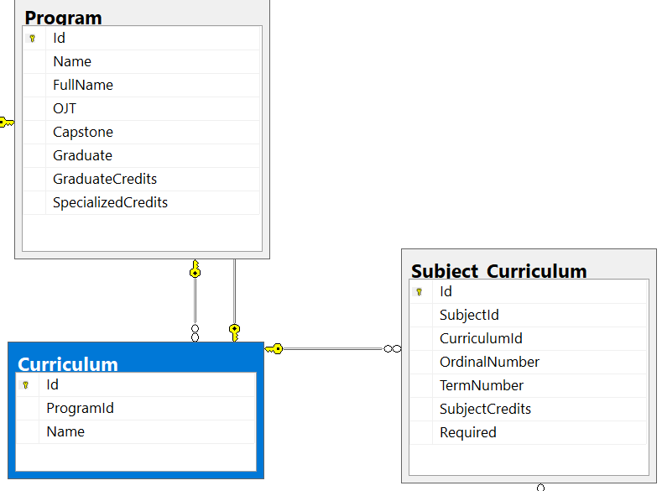
Students’ Train Process Management
Solutions
Database Tables
Curriculum
Curriculum’s information contains
Program
Subjects in each curriculum

Slide 98
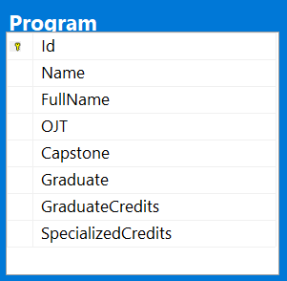
Students’ Train Process Management
Solutions
Database Tables
Program
“OJT”, “Capstone”, “Graduate” fields represent percentage of studied credits:
OJT: 90
Capstone: 80
Graduate: 100
These numbers represent how many percent of total curriculum credits
Student’s must pass a stage (percent x credits) to be able to qualify for next stage

Slide 99
Students’ Train Process Management
Solutions
Database Tables
Program
“GraduateCredits” Field represent minimum credits of each program that students need to acquired to graduate
SE : 145 credits
SB : 139 credits
Notes:
minimum

Slide 100
Students’ Train Process Management
Solutions
Database Tables
Program
“SpecializedCredits” field represent minimum credits in curriculum (exclude OJT and GDQP) of each program.
SE: 129 credits
SB: 120 credits

Slide 101
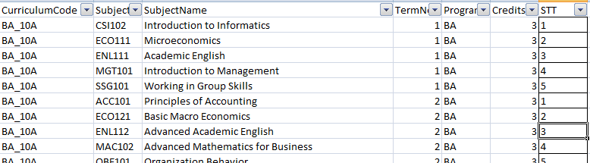
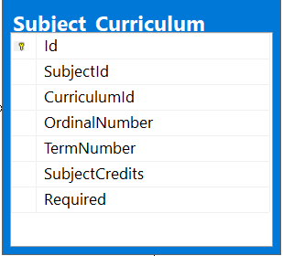
Students’ Train Process Management
Solutions
Database Tables
Subject Curriculum
“SubjectId” field represent subject code for each curriculum subject

Slide 102
Students’ Train Process Management
Solutions
Database Tables
Subject Curriculum
“TermNumber” field represent which term will the subject be set.

Slide 103
Students’ Train Process Management
Solutions
Database Tables
Subject Curriculum
“SubjectCredits” field represent subject’s credits

Slide 104
Students’ Train Process Management
Solutions
Database Tables
Curriculum
Current curriculum will be divided into 4 stage :
Initial Stage : English stage or base knowledge preparation stage.
Specialized stage : Core knowledge training stage.
OJT : On the job training stage
Major Specialized stage : Preparation for capstone project / graduation thesis defend.

Slide 105
Students’ Train Process Management
Solutions
Database Tables
Subject Curriculum
“Required” field is used to distinguish what subject is required or optional

Slide 106
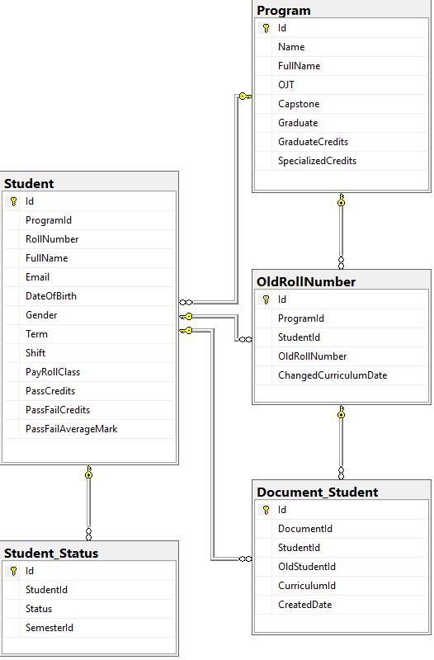
Students’ Train Process Management
Solutions
Database Tables
Curriculum
Student’s Information
Student’s information contains
Student’s program
Student’s current curriculum
Student’s old rollnumber (for students that have changed program)
Student’s status in specific semester

Slide 107
Students’ Train Process Management
Solutions
Database Tables
Curriculum
Student’s Information
When a student has changed their Program, the file will contains student’s old roll number.

Slide 108
Students’ Train Process Management
Solutions
Database Tables
Curriculum
Student’s Information
When a student has changed their Program, the file will contains student’s old roll number.
When we import the student, the system will create another student_document that contains their old rollnumber, so when we trace back, we’ll know when and where are the student from.

Slide 109
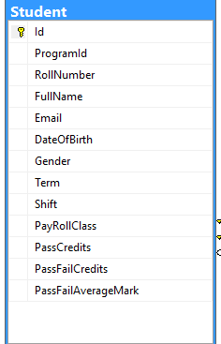
Students’ Train Process Management
Solutions
Database Tables
Curriculum
Student’s Information
“RollNumber” field represent student’s rollnumber

Slide 110
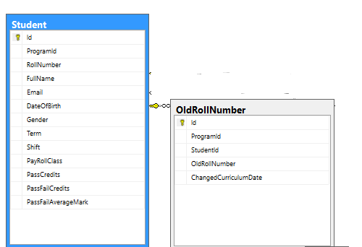
Students’ Train Process Management
Solutions
Database Tables
Curriculum
Student’s Information
“OldRollNumber” field represent student’s old roll number.

Slide 111
Students’ Train Process Management
Solutions
Database Tables
Curriculum
Student’s Information
“Term” field represent student’s current term number

Slide 112
Students’ Train Process Management
Solutions
Database Tables
Curriculum
Student’s Information
“Shift” field represent a student is studying in morning class (AM) or afternoon class (PM)
This will be assigned by training department staffs.

Slide 113
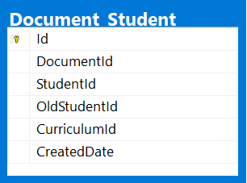
Students’ Train Process Management
Solutions
Database Tables
Curriculum
Student’s Information
“OldStudentId” field is used to save a student’s old data (Old curriculum before changing program) when a student have old roll number

Slide 114
Students’ Train Process Management
Solutions
Database Tables
Curriculum
Student’s Information
“CreatedDate” field is used to determine what current curriculum that a student is studying.

Slide 115
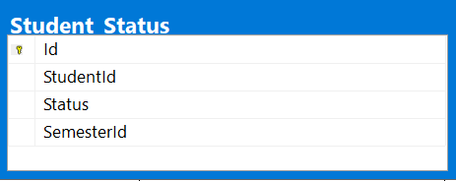
Students’ Train Process Management
Solutions
Database Tables
Curriculum
Student’s Information
“Status” field is used to determine student’s status in a specified semester.

Slide 116
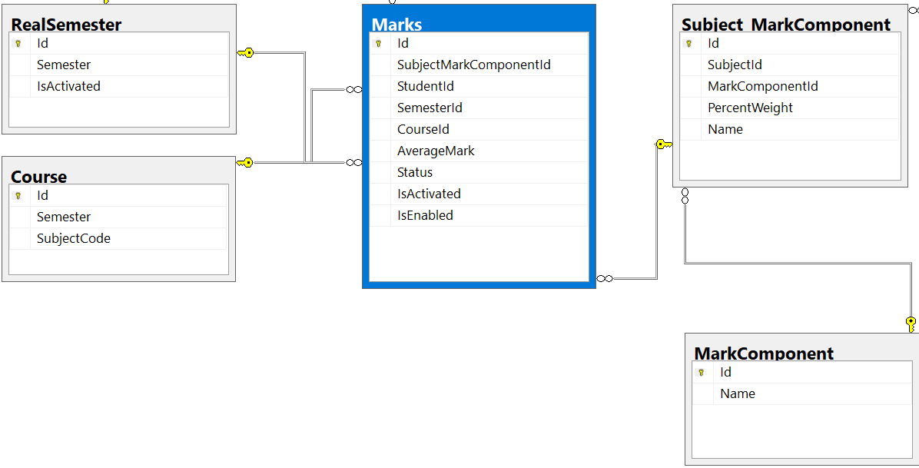
Students’ Train Process Management
Solutions
Database Tables
Curriculum
Student’s Information
Marks

Slide 117
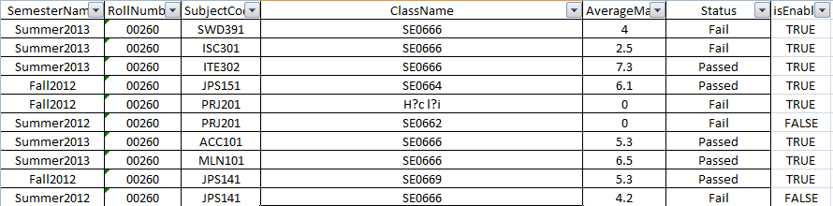
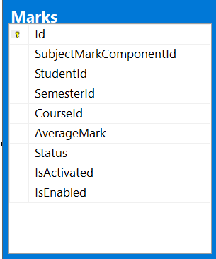
Students’ Train Process Management
Solutions
Database Tables
Curriculum
Student’s Information
Marks
“Status” field represent Mark’s status of a subject in a specified semester of a student (Fail, Passed, NotStart, Studying)

Slide 118
Students’ Train Process Management
Solutions
Database Tables
Curriculum
Student’s Information
Marks
“AverageMark” field represent subject’s final mark

Slide 119
Students’ Train Process Management
Solutions
Database Tables
Curriculum
Student’s Information
Marks
“CourseId” field represent course’s Id which is known as Class / course name

Slide 120
Students’ Train Process Management
Solutions
Database Tables
Curriculum
Student’s Information
Marks
“SemesterId” field represent semester’s id in which the mark is.

Slide 121
Students’ Train Process Management
Solutions
Database Tables
Curriculum
Student’s Information
Marks
“StudentId” field represent student’s id in Student table which have roll number in mark.

Slide 122
Students’ Train Process Management
Solutions
Database Tables
Curriculum
Student’s Information
Marks
“isActivated” field is used to distinguish which subject’s mark is not used or is used when students change their program
Acquired subject will be recorded into system with isActivated = true.
Notes:
Mon dc cong nhan se duoc giu lai diem voi trang thai isActivated = true.

Slide 123
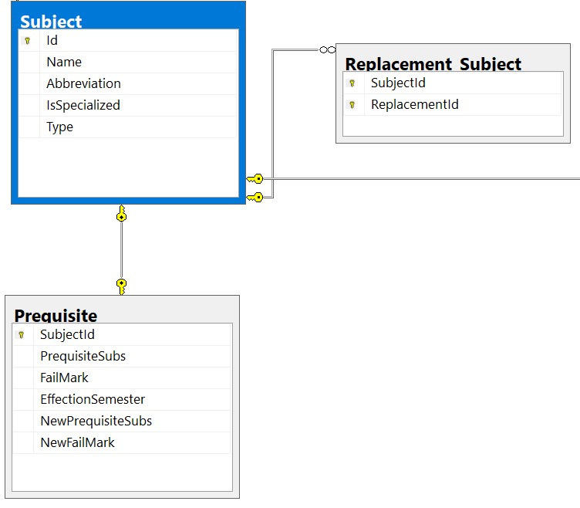
Students’ Train Process Management
Solutions
Database Tables
Curriculum
Student’s Information
Marks
Subjects

Slide 124
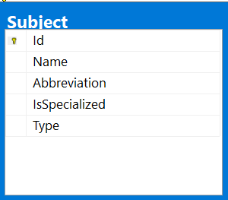
Students’ Train Process Management
Solutions
Database Tables
Curriculum
Student’s Information
Marks
Subjects
“Type” field is used to distinguish OJT and Capstone with normal subjects

Slide 125
Students’ Train Process Management
Solutions
Database Tables
Curriculum
Student’s Information
Marks
Subjects
“Type” field is used to distinguish OJT and Capstone with normal subjects
“Type” is a numberic field
The system provide 2 types of subjects which defined in an ENUM class:
1: define OJT, OJS, OJB subjects
2: define SWP, SWQ, GRA subjects

Slide 126
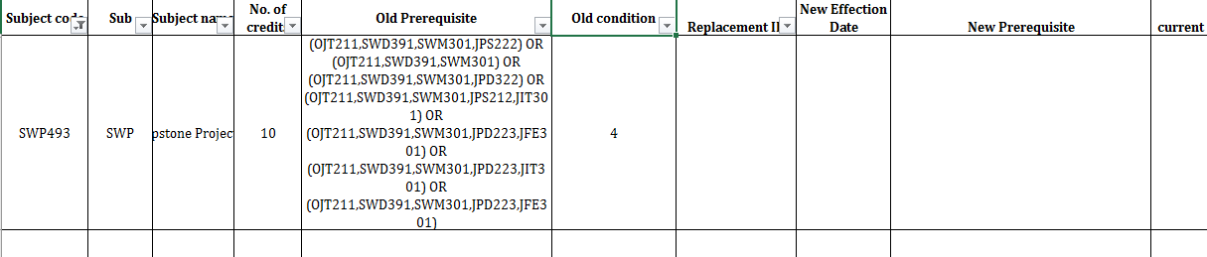
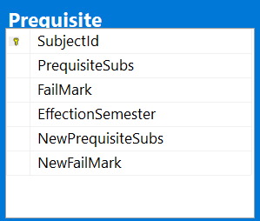
Students’ Train Process Management
Solutions
Database Tables
Curriculum
Student’s Information
Marks
Subjects
“PrequisiteSubs” field and “FailMark” field represent subject’s current prerequisite and current fail mark when “EffectionSemester” is empty.
User must have knowledge about prerequisite to be able to update these field.
Notes:
Ng dung bat buoc phai co kien thuc ve viec cap nhat yeu cau tien quyet

Slide 127
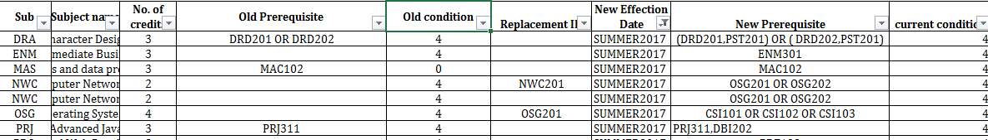
Students’ Train Process Management
Solutions
Database Tables
Curriculum
Student’s Information
Marks
Subjects
When “EffectionSemester” is not empty, “PrequisiteSubs” field and “FailMark” field represent subject’s old prerequisite and old fail mark before “EffectionSemester”. “NewPrequisiteSubs” and “NewFailMark” field represent subject’s new prerequisite and new fail mark after “EffectionSemester”.

Slide 128
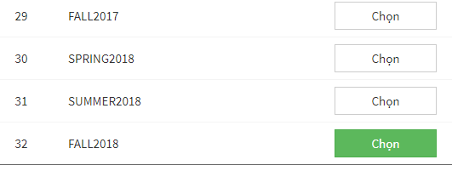
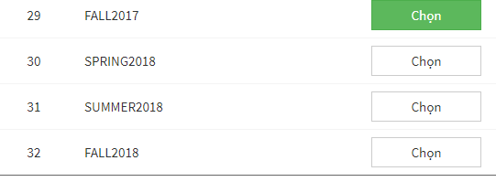
Students’ Train Process Management
Solutions
Expected Features
Simulate Semester
Simulate current semester to generate pass statistic data and make reports
Chọn kỳ để giả định

Slide 129
Students’ Train Process Management
Solutions
Expected Features
Simulate Semester
The Purpose of simulate semester is to know when and how many students have passed or enough to pass a specific stage, the main reason is to generate statistic reports for studies.
This function is mainly for Student Details, to know each student pass’ studies so university can provide better teaching and guess student’s future plans

Slide 130
Students’ Train Process Management
Solutions
Expected Features
Simulate Semester
The Pros
The Cons
Make reports for pass data
Test integrity of the data from pass to now
Not always correct, the result may slightly different than calculate by hands
The Purpose of simulate semester is to know when and how many students have passed or enough to pass a specific stage, the main reason is to generate statistic reports for studies.
This function is mainly for Student Details, to know each student pass’ studies so university can provide better teaching and guess student’s future plans

Slide 131
Students’ Train Process Management
Solutions
Expected Features
Simulate Semester
How simulate works ?
Sorted list semesters

Slide 132
Students’ Train Process Management
Solutions
Expected Features
Simulate Semester
How simulate works ?
Current Semester (Real)
Sorted list semesters
Temporary Semester (Simulated)

Slide 133
Students’ Train Process Management
Solutions
Expected Features
Simulate Semester
How simulate works ?
Current Semester (Real)
Sorted list semesters
indexOf currentsemester
–
indexOf temporarysemester
=
gap
Temporary Semester (Simulated)

Slide 134
Students’ Train Process Management
Solutions
Expected Features
Simulate Semester
How simulate works ?
Calculate the gap between two semester, the idea is to minus student term with the gap to get their old data and query get semesters from beginning till temporary semester set by admin
Current Semester (Real)
Sorted list semesters
indexOf currentsemester
–
indexOf temporarysemester
=
gap
Temporary Semester (Simulated)

Slide 135

Students’ Train Process Management
Solutions
Expected Features
Simulate Semester
Demo simulate semesters

Slide 136
Students’ Train Process Management
Solutions
Expected Features
Simulate Semester
Demo Simulate semesters

Slide 137
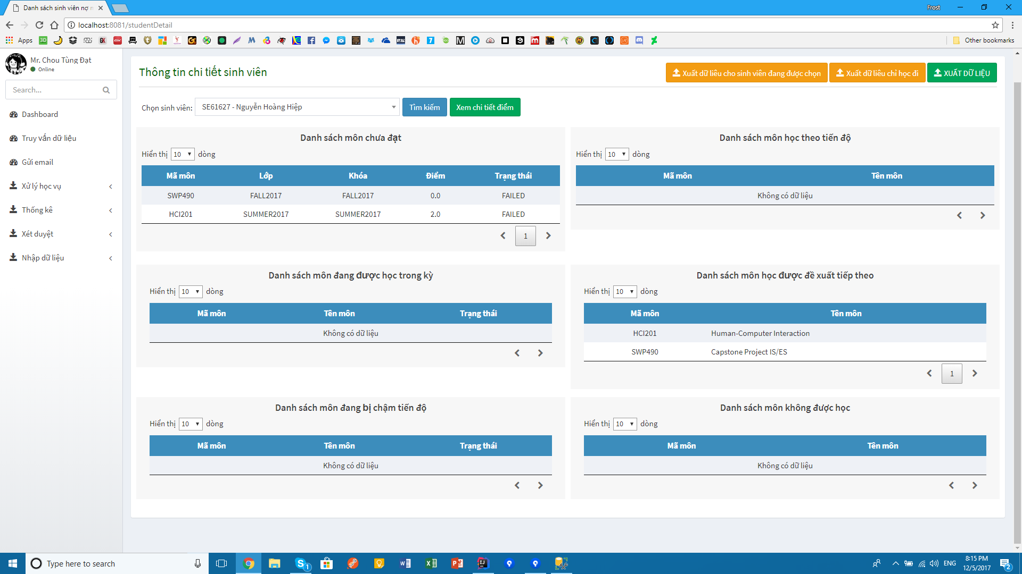
Students’ Train Process Management
Solutions
Expected Features
Get Student’s Detail
Figure 1a. Interface

Slide 138
Students’ Train Process Management
Solutions
Expected Features
Get Student’s Detail
Studying Subjects
Failed Subjects
Next Subjects
6 Tables
Not Start Subjects
Can’t Study Subjects
Suggestion Subjects
Figure 1a. Interface

Slide 139
Students’ Train Process Management
Solutions
Expected Features
Get Student’s Detail
How can we get student suggestion subjects ?
Get student failed subjects

Slide 140
Students’ Train Process Management
Solutions
Expected Features
Get Student’s Detail
How can we get student suggestion subjects ?
Larger than 6
Get student failed subjects

Slide 141
Students’ Train Process Management
Solutions
Expected Features
Get Student’s Detail
How can we get student suggestion subjects ?
Suggest student to study all failed subjects
yes
Larger than 6
Get student failed subjects
no
Combine with Next subjects and Not start subjects

Slide 142
Students’ Train Process Management
Solutions
Expected Features
Get Student’s Detail
How can we get student suggestion subjects ?
Suggest student to study all failed subjects
yes
Larger than 6
Get student failed subjects
Sort priority by Subjects in term ascending
no
Combine with Next subjects and Not start subjects

Slide 143
Students’ Train Process Management
Solutions
Expected Features
Get Student’s Detail
How can we get student suggestion subjects ?
Suggest student to study all failed subjects
yes
Larger than 6
Get student failed subjects
Sort priority by Subjects in term ascending
Display the top 7
no
Combine with Next subjects and Not start subjects

Slide 144
Students’ Train Process Management
Solutions
Expected Features
Get Student’s Detail
Process Steps
Step 1: Find all failed, not start and next subjects
Step 2: Sort by term number ascending
Step 3: Combine and then check prerequisite
If a subject violated, subject will be pushed to can’t study table
If subjects contain OJT or SWP, check for total credits and prequisite (For OJT, if student qualified for OJT, then only OJT and SYB are shown on table, others pushed to can’t study table)
Step 4: Display top 7

Slide 145
Students’ Train Process Management
Solutions
Expected Features
Get Student’s Detail
Demo Get Student’s Detail

Slide 146
Students’ Train Process Management
Solutions
Expected Features
Get Student’s Detail
Demo Get Student’s Detail

Slide 147
Students’ Train Process Management
Solutions
Expected Features
Get Passed Stage Students List
Goal
Display list of students who passed either OJT or Capstone or Graduation states
Process Steps
Match with student’s curriculum to get only passed subjects and calculate total passed credits
Multiply with curriculum’s total credits and percent of the state (A)
Get students where (A) has passed the requirement
147

Slide 148
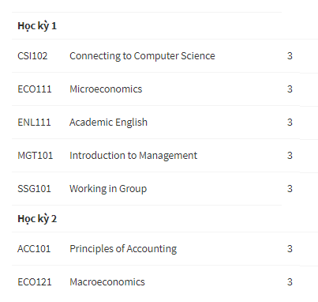
Students’ Train Process Management
Solutions
Expected Features
Get Passed Stage Students List
How it works?
Calculate total requirement

Slide 149
Students’ Train Process Management
Solutions
Expected Features
Get Passed Stage Students List
How it works?
Calculate total requirement
Get percent of respective curriculum
For example:
OJT: 75
Capstone: 120
Graduation: 145

Slide 150
Students’ Train Process Management
Solutions
Expected Features
Get Passed Stage Students List
How it works?
Display on table
Calculate total requirement
Get percent of respective curriculum
Do nothing
For example:
OJT: 75
Capstone: 120
Graduation: 145
For example:
- OJT require 90% of 5 first time => requirement is only 75 x 90% = 68

Slide 151
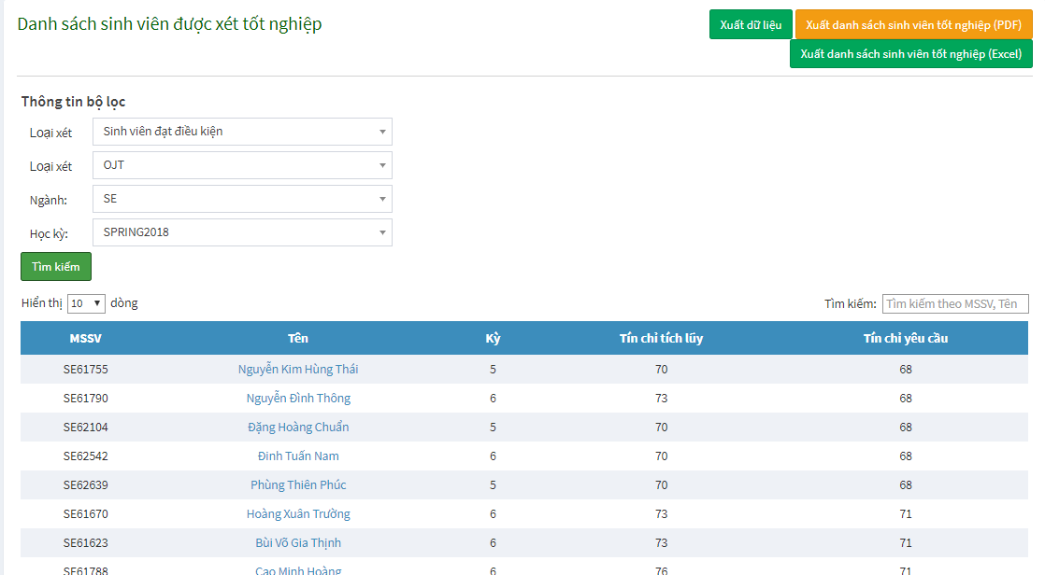
Students’ Train Process Management
Solutions
Expected Features
Get Passed Stage Students List
Display format

Slide 152
Students’ Train Process Management
Solutions
Expected Features
Get Passed Stage Students List
Demo Get Passed Stage Students List

Slide 153
Students’ Train Process Management
Solutions
Expected Features
Get Passed Stage Students List
Demo Get Passed Stage Students List

Slide 154
Students’ Train Process Management
Solutions
Expected Features
Create Course Classes into Slots in specific Semester
Goal

Slide 155
Students’ Train Process Management
Solutions
Expected Features
Create Course Classes into Slots in specific Semester
Goal
Divide all student groups which belong to subject group into subject class follow by slot, then put them into one class with maximum number of student is 25.

Slide 156
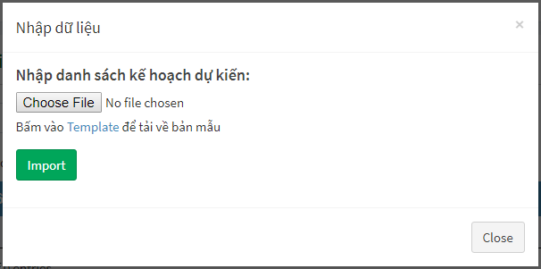
Students’ Train Process Management
Solutions
Expected Features
Create Course Classes into Slots in specific Semester

Slide 157
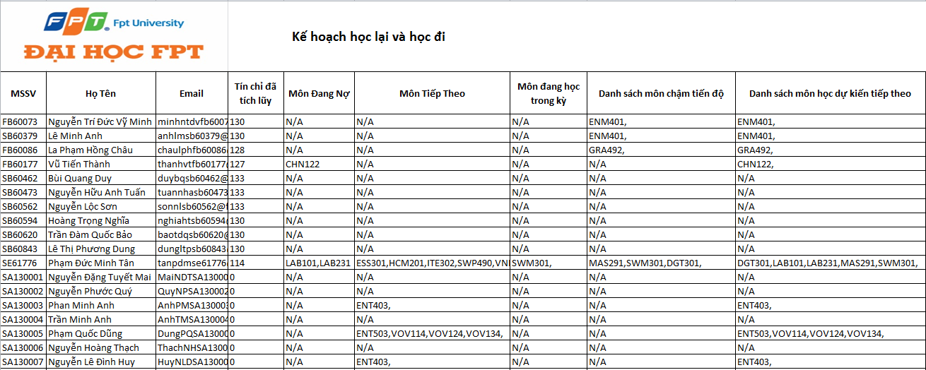
Students’ Train Process Management
Solutions
Expected Features
Create Course Classes into Slots in specific Semester

Slide 158
Students’ Train Process Management
Solutions
Expected Features
Create Course Classes into Slots in specific Semester

Slide 159
Students’ Train Process Management
Solutions
Expected Features
Create Course Classes into Slots in specific Semester

Slide 160
Students’ Train Process Management
Solutions
Expected Features
Create Course Classes into Slots in specific Semester
Process Steps
Get expected subject list

Slide 161
Students’ Train Process Management
Solutions
Expected Features
Create Course Classes into Slots in specific Semester
Process Steps
Get expected subject list
Get student’s shift list in system

Slide 162
Students’ Train Process Management
Solutions
Expected Features
Create Course Classes into Slots in specific Semester
Process Steps
Get expected subject list
Group student list into slots, student’s slots are not duplicated
Get student’s shift list in system

Slide 163
Students’ Train Process Management
Solutions
Expected Features
Create Course Classes into Slots in specific Semester
Process Steps
Get expected subject list
Group student list into slots, student’s slots are not duplicated
Create course classes with 25 students each class
Get student’s shift list in system

Slide 164
Students’ Train Process Management
Solutions
Expected Features
Create Course Classes into Slots in specific Semester
Process Steps
Get expected subject list
Group student list into slots, student’s slots are not duplicated
Create course classes with 25 students each class
Display result
Get student’s shift list in system

Slide 165
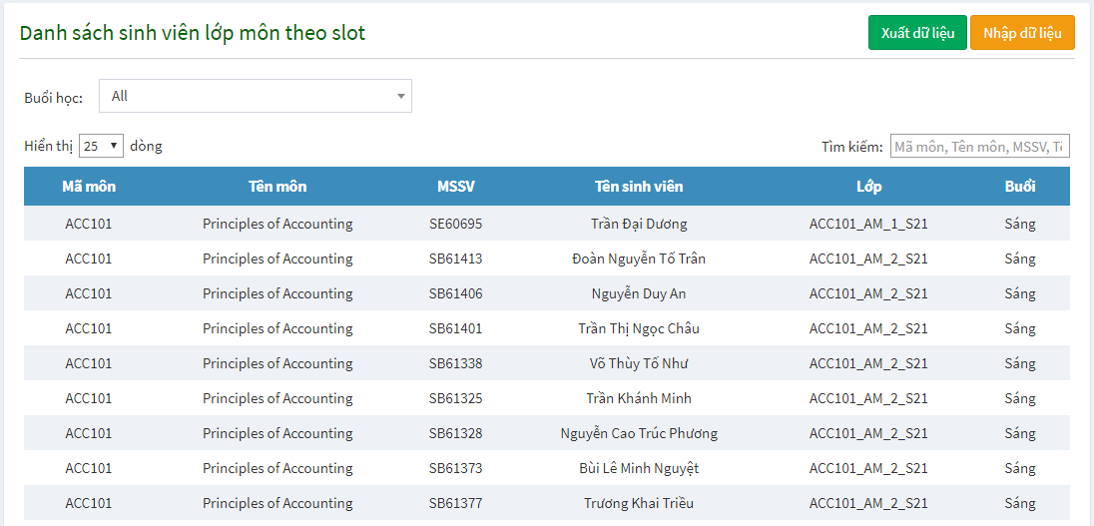
Students’ Train Process Management
Solutions
Expected Features
Create Course Classes into Slots in specific Semester
Display format

Slide 166
Students’ Train Process Management
Solutions
Expected Features
Create Course Classes into Slots in specific Semester
Demo Create Course Classes into Slots in specific Semester

Slide 167
Students’ Train Process Management
Solutions
Expected Features
Create Course Classes into Slots in specific Semester
Demo Create Course Classes into Slots in specific Semester

Slide 168
Students’ Train Process Management
Solutions
What can Staffs do ?
Make Statistic
Failed Statistics

Slide 169
Students’ Train Process Management
Solutions
What can Staffs do ?
Make Statistic
Failed Statistics
Number of failed subjects at the beginning of required semester

Slide 170
Students’ Train Process Management
Solutions
What can Staffs do ?
Make Statistic
Failed Statistics
Number of failed subjects at the beginning of required semester
Number of passed subjects in required semester (paid for failed subjects at the beginning of required semester)

Slide 171
Students’ Train Process Management
Solutions
What can Staffs do ?
Make Statistic
Failed Statistics
Number of failed subjects at the beginning of required semester
Number of passed subjects in required semester (paid for failed subjects at the beginning of required semester)
Number of failed subjects in required semester

Slide 172
Students’ Train Process Management
Solutions
What can Staffs do ?
Make Statistic
Failed Statistics
Number of failed subjects at the beginning of required semester
Number of passed subjects in required semester (paid for failed subjects at the beginning of required semester)
Number of failed subjects in required semester
Number of passed subjects in required semester (paid for failed subjects in required semester)

Slide 173
Students’ Train Process Management
Solutions
What can Staffs do ?
Make Statistic
Failed Statistics
Number of failed subjects at the beginning of required semester
Number of passed subjects in required semester (paid for failed subjects at the beginning of required semester)
Number of failed subjects in required semester
Number of passed subjects in required semester (paid for failed subjects in required semester)
Number of registered to relearn failed subject in required semester

Slide 174
Students’ Train Process Management
Solutions
What can Staffs do ?
Make Statistic
Failed Statistics
Number of failed subjects at the beginning of required semester
Number of passed subjects in required semester (paid for failed subjects at the beginning of required semester)
Number of failed subjects in required semester
Number of passed subjects in required semester (paid for failed subjects in required semester)
Number of registered to relearn failed subject in required semester
Number of failed subjects at the end of required semester

Slide 175
Students’ Train Process Management
Solutions
What can Staffs do ?
Make Statistic
Failed Statistics
Number of failed subjects at the beginning of required semester
If passed
Remove subject from A
Subject’s replacement passed or not passed ?
Get all failed subjects (A)
Final failed subjects at begin
If not passed
Do nothing

Slide 176
Students’ Train Process Management
Solutions
What can Staffs do ?
Make Statistic
Failed Statistics
Number of passed subjects in required semester (paid for failed subjects at the beginning of required semester)
Final failed subjects at begin (B)

Slide 177
Students’ Train Process Management
Solutions
What can Staffs do ?
Make Statistic
Failed Statistics
Number of passed subjects in required semester (paid for failed subjects at the beginning of required semester)
Final failed subjects (B)
Get all passed subjects (C)

Slide 178
Students’ Train Process Management
Solutions
What can Staffs do ?
Make Statistic
Failed Statistics
Number of passed subjects in required semester (paid for failed subjects at the beginning of required semester)
Subject existed in C ?
Final failed subjects (B)
Get all passed subjects (C)

Slide 179
Students’ Train Process Management
Solutions
What can Staffs do ?
Make Statistic
Failed Statistics
Number of passed subjects in required semester (paid for failed subjects at the beginning of required semester)
Add subject in passed list (D)
Subject existed in C ?
If existed
Final failed subjects (B)
If not existed
Do nothing
Get all passed subjects (C)

Slide 180
Students’ Train Process Management
Solutions
What can Staffs do ?
Make Statistic
Failed Statistics
Number of passed subjects in required semester (paid for failed subjects at the beginning of required semester)
Add subject in paid list (D)
Subject existed in C ?
If existed
Final failed subjects (B)
Paid List
If not existed
Do nothing
Get all passed subjects (C)

Slide 181
Students’ Train Process Management
Solutions
What can Staffs do ?
Make Statistic
Failed Statistics
Number of failed subjects in required semester
If passed
Remove subject from A
Subject’s replacement passed or not passed ?
Get all failed subjects (A)
Final failed subjects in semester
If not passed
Do nothing

Slide 182
Students’ Train Process Management
Solutions
What can Staffs do ?
Make Statistic
Failed Statistics
Number of failed subjects at the end of required semester
Final failed subjects at the end
Final failed subjects at begin
Paid List
Final failed subjects in semester

Slide 183
Students’ Train Process Management
Solutions
What can Staffs do ?
Make Statistic
Failed Statistics
Number of passed subjects in required semester (paid for failed subjects in required semester)
Get all failed and passed subjects

Slide 184
Students’ Train Process Management
Solutions
What can Staffs do ?
Make Statistic
Failed Statistics
Number of passed subjects in required semester (paid for failed subjects in required semester)
Get all failed and passed subjects
Group subject marks by student and subject

Slide 185
Students’ Train Process Management
Solutions
What can Staffs do ?
Make Statistic
Failed Statistics
Number of passed subjects in required semester (paid for failed subjects in required semester)
Check marks list contains more than 2 and passed
Get all failed and passed subjects
Group subject marks by student and subject

Slide 186
Students’ Train Process Management
Solutions
What can Staffs do ?
Make Statistic
Failed Statistics
Number of passed subjects in required semester (paid for failed subjects in required semester)
Increase count variable by 1
If meet requirement
Check marks list contains more than 2 and passed
Get all failed and passed subjects
Group subject marks by student and subject
If not
Do nothing

Slide 187
Students’ Train Process Management
Solutions
What can Staffs do ?
Make Statistic
Failed Statistics
Number of passed subjects in required semester (paid for failed subjects in required semester)
Increase count variable by 1
If meet requirement
Check marks list contains more than 2 and passed
Number of passed subjects
Get all failed and passed subjects
Group subject marks by student and subject
Do nothing
If not

Slide 188
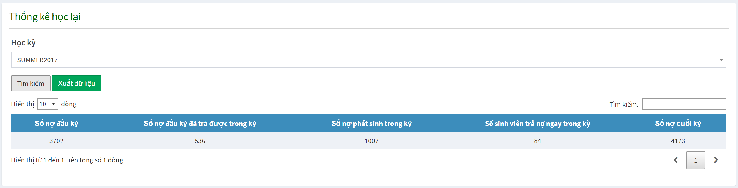
Students’ Train Process Management
Solutions
What can Staffs do ?
Make Statistic
Failed Statistics

Slide 189
Students’ Train Process Management
Solutions
Expected Features
Make statistics
Demo make Statistics

Slide 190
Students’ Train Process Management
Solutions
Expected Features
Make statistics
Demo make Statistics

Slide 191
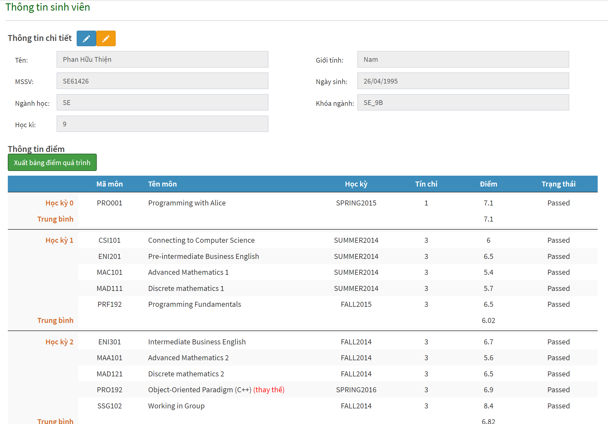
Students’ Train Process Management
Solutions
Expected Features
Interim Academic Transcript
Display student’s interim academic transcript, also allow staff to modify student’s information such as name, gender, date of birth or term number

Slide 192
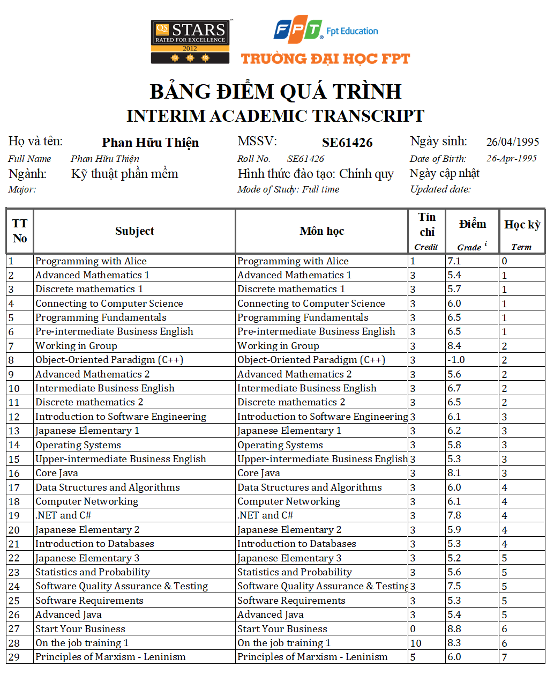
Students’ Train Process Management
Solutions
Expected Features
Interim Academic Transcript
This is Mr. Thien’s interim academic transcript which is exported from system.

Slide 193
Students’ Train Process Management
Solutions
Expected Features
Interim Academic Transcript
Demo Create Course Classes into Slots in specific Semester

Slide 194
Students’ Train Process Management
Solutions
Expected Features
Interim Academic Transcript
Demo Create Course Classes into Slots in specific Semester

Slide 195
Students’ Train Process Management
Outcome and limitation
Solved problems
sdasdw
Staff

Slide 196

Students’ Train Process Management
Outcome and limitation
Solved problems
sdasdw
Staff
Student’s detail in specific semester

Slide 197
Students’ Train Process Management
Outcome and limitation
Solved problems
sdasdw
Request
Staff
Student’s detail in specific semester

Slide 198

Students’ Train Process Management
Outcome and limitation
Solved problems
sdasdw
New System
Request
Staff
Student’s detail in specific semester
Old system

Slide 199
Students’ Train Process Management
Outcome and limitation
Solved problems
sdasdw
New System
Request
Staff
Not supported
Student’s detail in specific semester
Old system

Slide 200
Students’ Train Process Management
Outcome and limitation
Solved problems
sdasdw
Supported
New System
Request
Staff
Not supported
Student’s detail in specific semester
Old system

Slide 201
Students’ Train Process Management
Outcome and limitation
Solved problems
sdasdw
Manage student, subject

Slide 202
Students’ Train Process Management
Outcome and limitation
Solved problems
sdasdw
Make statistic report
Manage student, subject

Slide 203
Students’ Train Process Management
Outcome and limitation
Solved problems
sdasdw
Preparation tasks for next semester
Make statistic report
Manage student, subject

Slide 204
Students’ Train Process Management
Outcome and limitation
Solved problems
sdasdw
Preparation tasks for next semester
Make statistic report
Manage student, subject
Old system

Slide 205

Students’ Train Process Management
Outcome and limitation
Solved problems
sdasdw
Preparation tasks for next semester
Make statistic report
Manage student, subject
Old system
Manual

Slide 206
Students’ Train Process Management
Outcome and limitation
Solved problems
sdasdw
Preparation tasks for next semester
Make statistic report
Manage student, subject
New System
Old system
Manual

Slide 207
Students’ Train Process Management
Outcome and limitation
Solved problems
sdasdw
Preparation tasks for next semester
Make statistic report
Manage student, subject
Supported
New System
Old system
Manual

Slide 208
Students’ Train Process Management
Outcome and limitation
Limitation
sdasdw
New system still demand on current system’s data.
Current data’s accuracy is not verified.
We hope that user can adapt new system quickly

Slide 209
Students’ Train Process Management
Outcome and limitation
Future plans
sdasdw

Slide 210
Students’ Train Process Management
Outcome and limitation
Future plans
sdasdw
New System

Slide 211

Students’ Train Process Management
Outcome and limitation
Future plans
sdasdw
Designed Database
New System

Slide 212
Students’ Train Process Management
Outcome and limitation
Future plans
sdasdw
Designed Database
New System

Slide 213
Students’ Train Process Management
Outcome and limitation
Future plans
sdasdw
Designed Database
New System
Status unified

Slide 214
Students’ Train Process Management
Outcome and limitation
Future plans
sdasdw
Designed Database
New System
Status unified

Slide 215

Students’ Train Process Management
Outcome and limitation
Future plans
sdasdw
Designed Database
New System
Status unified
Standardized input / output

Slide 216
Students’ Train Process Management
Outcome and limitation
Future plans
sdasdw
Designed Database
New System
Status unified
Standardized input / output

Slide 217
Students’ Train Process Management
Thank you for your listening

Slide 218
Students’ Train Process Management
Q & A

